Slide 1
Social Media Remarketing
Making the Most of Your Traffic

Slide 2
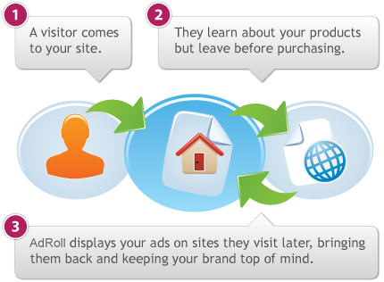
What is Remarketing?
Generally 2% of shoppers convert on the first visit to an online store. Retargeting brings back the other 98%. Retargeting works by keeping track of people who visit your site and displaying your retargeting ads to them as they visit other sites online.

Slide 3
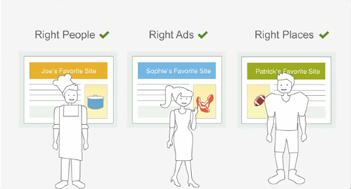
What is Remarketing?
The high click-through rates and increased conversions that are typical with retargeting campaigns underscore the value of good branding and repeated exposure.
Remarketing generally increases conversion rates by 300-400%, reducing your cost per lead

Slide 4
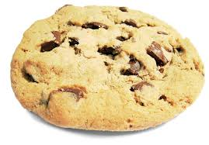
How Is This Possible?
Remarketing places a cookie on the website browser of visitors that have been to your website before, allowing you to target ads to them again at a cheaper rate
A cookie is a piece of text that a Web server can store on a user's hard disk. Cookies allow a Web site to store information on a user's machine and later retrieve it.
They cannot gather any information on their own. Nor can they collect any personal information about you from your machine.

Slide 5
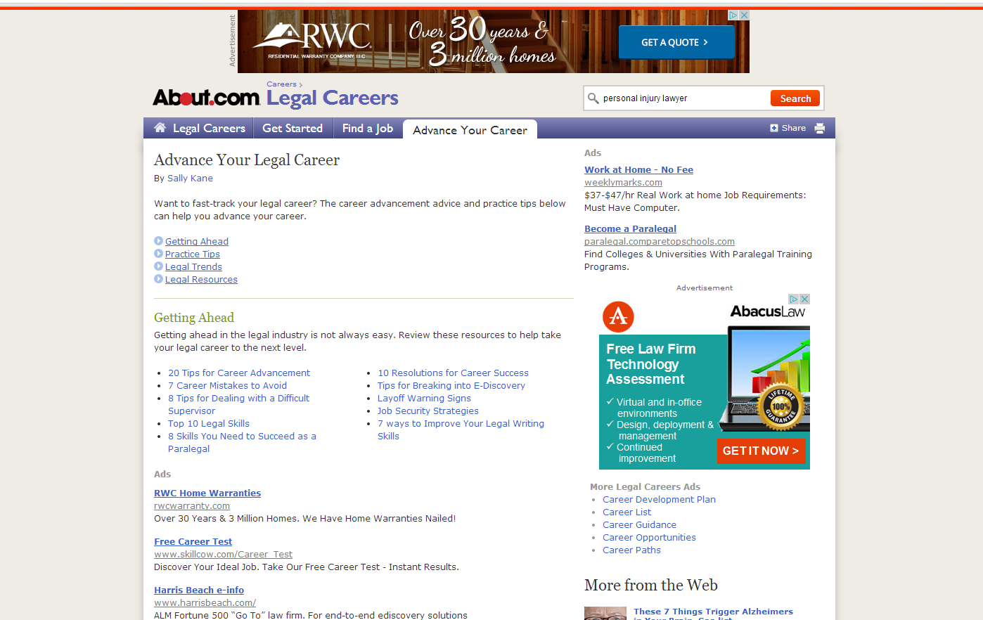
Google Display Network
Remarketing in the Google Display Network using banner ads is highly effective

Slide 6
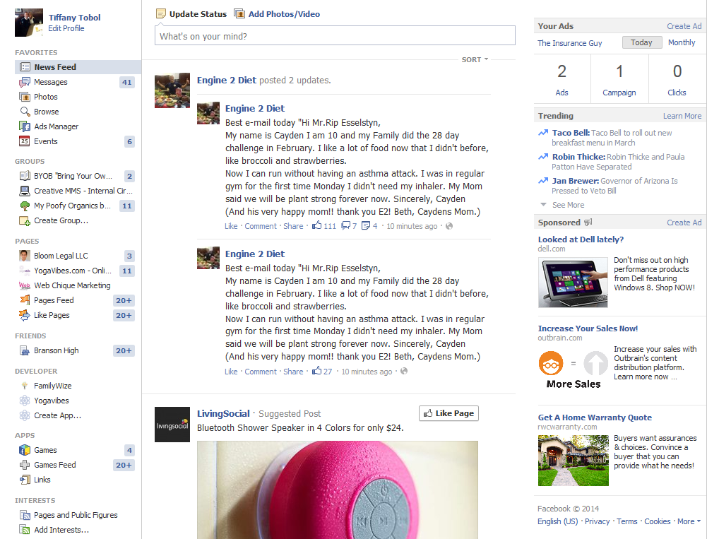
Facebook Remarketing via Adroll
Adroll .com offers remarketing via Facebook sidebar ads

Slide 7
How To Setup
Google Display Remarketing:
Setup an Adwords account
Setup a remarketing campaign
Install a piece of code on your website
Design banner ads in 300x250, 728x90, 160x600
Facebook Remarketing Campaign
Add a Privacy Policy to your website
Setup an AdRoll account
Choose pics and write your ads
Install a tracking pixel on your website

Slide 8
Pros & Cons
Pros
Currently costs about $0.25 - $1 per click
Very few people are using it yet
Gives the impression to potential clients that you have a huge marketing budget
Needs very little maintenance
Cons
You have to have traffic for it to work
Technical to setup, helps to have a team

Slide 9
What’s Next
Twitter to launch remarketing options
Prices will slowly increase
Efficacy will drop as people learn what remarketing is
Next 2-3 years is the bubble to take advantage of this

