Slide 1
SEO 101: Improve your Site with Simple Steps
By PaperStreet Web Design

Slide 2
What is SEO?
Search engine optimization (SEO) is the process of improving the visibility of a website or a web page in search engines, via search results.

Slide 3
Why Google?
* Comscore November 2011 (Google 65.4%, Yahoo 15.1%, Bing 15%, and Other 4.5%

Slide 4
SEO REALLY works.
"We are getting 3 to 6 new web inquiries per day We are signing about one new client per day. We have to turn away business because we are so busy.”

Slide 5
SEO is Easy. Simple changes to your site.

Slide 6
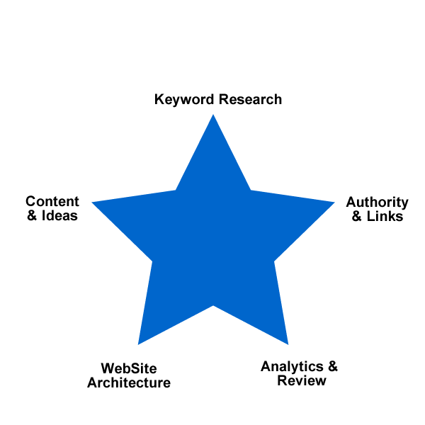
Key Areas to Review

Slide 7
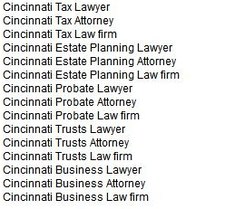
1st Step : RESEARCH This can be done in 3 minutes. So no excuses.
Keyword
Brainstorm
Compile
Keyword Phrases
Research in
Google

Slide 8
Keyword Brainstorm Example: http://grafstiebel.com
List your geographic locations:
Cincinnati
http://grafstiebel.com/contact.php
List your practice areas:
Tax, Estate Planning, Probate, Trusts, Business
http://grafstiebel.com/practice-areas.php
Add in the terms:
Lawyer, Attorney and Law firm
You are Done Brainstorming.

Slide 9
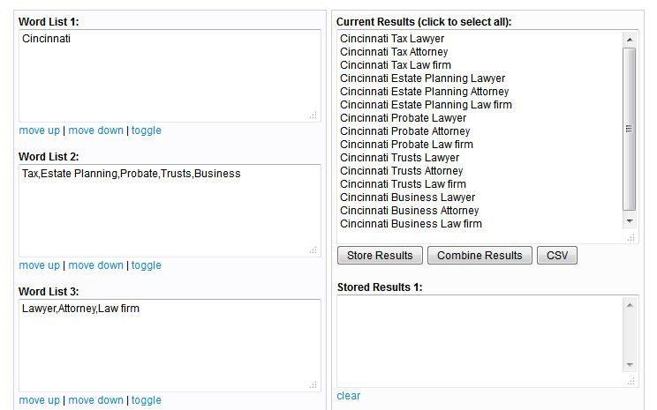
Compile Keyword Phrases http://www.paperstreet.com/generator/

Slide 10
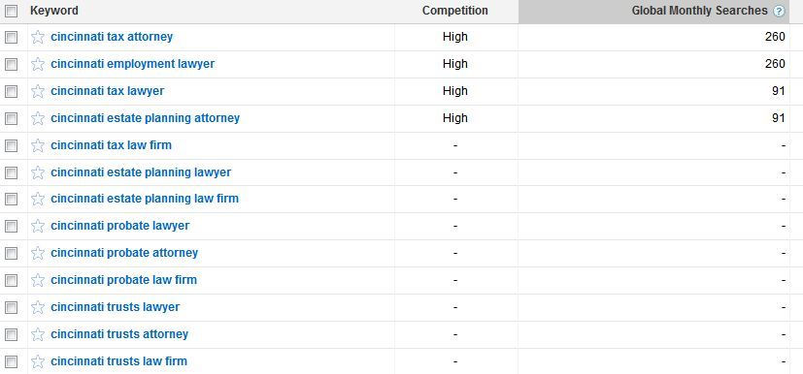
Research at Google What are people searching?
https://adwords.google.com/select/KeywordToolExternal

Slide 11
2nd Step: On-Page Optimization Easy Stuff to Fix.
Client Controlled
Web Developer Controlled
Title Tags
Meta Description
Headlines
Content
Footer Text
Page Names
Duplicate Content
Proper Redirects
No Errors
No Hidden Text, Stuffing, & Being Spammy

Slide 12
Title Tags
Good
Key West Criminal Defense Attorney
Improve
Graf & Stiebel (firm name only)
Tip:
Include keyword phrases in your title tags. Separate by commas. Limit to 65 characters.

Slide 13
Meta Description
Good
Improve
“Donald C. Barrett, P.A is a Florida Keys based experienced criminal defense lawyer and attorney has more than ten years of experience in criminal law and DUI ...”
Not having one!
Google will pull text from the page.
Tip:
Include a Meta Description with calls to action, experience, and why to choose you.

Slide 14
Headlines
Good
“New Jersey Employment and Labor Lawyers”
Improve
“Welcome to Granite Management”
Tip:
Include keyword phrases in your headlines. Don’t say Welcome…..
Headlines should be in HTML text (not graphics).

Slide 15
Content
Good
Improve
Tip:
Cover all practice areas and keyword phrases. Don’t have splash pages.

Slide 16
Footer Text
Good
Improve
Tip:
Don’t Be Spammy. There are elegant ways to get the same information on the page.
Include SOME practice areas and cities – but not a laundry list.

Slide 17
Page Names
Good
http://www.bloomlegal.com/Personal-Injury/Car-Accident/
http://www.bloomlegal.com/Criminal-Defense/DWI-DUI/DUI-Louisiana/
Improve
http://aelex.com/practices.php?headline=Admiralty+and+Maritime
http://www.hannalawoffice.com/?page_id=7
Tip:
Better to have page names that are easy to remember and contain keyword phrases.

Slide 18
Duplicate Content
Can Happen When….
Tip: How to Avoid…
Printer Friendly Pages
Sessions
Home Page Versions
Blog Versions
Index Only One Version of your Website.
Use Canonical Tags on duplicate content.
<link rel="canonical" href="http://www.paperstreet.com" />
Don’t Copy!

Slide 19
Proper Redirects
Good
Improve
www.bloomlegal.com
www.schallandbarasch.com
Home page redirects to those pages and does not load index.php or some similar page.
Anytime your site will load with all the following variables:
www.domain.com/
Domain.com
www.domain.com/index.php
Domain.com/index.php
Tip:
Always use only www or non-www. Easy fix in the .htaccess file.

Slide 20
No Errors
Good
Improve
Check Webmaster Tools
Fix any errors
Spelling
404 Errors
Server Speed
Tip:
Sign up for Google Webmaster Tools.

Slide 21
Don’t Be Spammy
Good
Improve
Clear Hierarchy and Links
Sitemap
Don’t repeat keyword phrases throughout copy.
Don’t stuff keyword phrases.
Create a useful, information-rich site, and write pages that clearly and accurately describe your content.
Make pages primarily for users, not for search engines.
Avoid tricks intended to improve search engine rankings.
Don't participate in link schemes designed to increase your site's ranking or PageRank.
Tip:
When in doubt, write and develop the website for real people.

Slide 22
3rd Step: Authority (Link Building) Become a Resource & Authority Online
CSS

Slide 23
3rd Step: Authority (Link Building) Become a Resource & Authority Online
Paid Directories & Free Directories
Local Submission
Social media integration and submission
Vendors, Clients, & Research
Valid Article & Press release submission
Blog: Write about Interesting Ideas

Slide 24
Paid Directories & Free Directories
Free – Sign Up!
Paid – Consider Purchasing
Avvo.com
lawyers.justia.com
Yelp.com
Design Galleries (if your website is good)
Social Sites: Google+, LinkedIn, Facebook, and Twitter.
dir.yahoo.com
Business.com
BOTW.org
UBL.org
HG.org
PRWeb.com
JoeAnt.com
Martindale.com
Findlaw.com
lawyers.law.cornell.edu/ (Donate)

Slide 25
Local Submission
Google.com/places/
local.yahoo.com
bing.com/local/
UBL.org
HotFrog.com

Slide 26
Social Media
Tip:
Get signed up with the Big Four.

Slide 27
Vendors, Clients, & Research
Use OpenSiteExplorer.org to Find Competitive Links!
Ask Current Clients for Links
Ask Vendors for Links
If you speak at a conference, get links to your bios.

Slide 28
Valid Article & Press Releases
Bad:
Don’t Spam.
Don’t write poor content just for SEO.
Good:
If you have something new, write a press release. PRWeb.com is great.
If you write a good post, syndicate to other blogs, JDSupra.com, HG.org, and other legal portals.

Slide 29
Blog: Write about Interesting Ideas.
Schedule a monthly publication meeting with your team (associates, writers, designers).
Brainstorm Ideas.
Assign posts and due dates.
Have an editor in charge.
PUBLISH!

Slide 30
4th Step: Content Plan Write. Write. Write.
Correlation between posting often and ranking high.
Ideas: Practice Areas, Keyword Research & Client Questions
Structure of Content:
Place your best content higher on the page
No keyword stuffing
Internal links with keywords
Contact info on each page

Slide 31
5th Step: Analytics Check your Progress.

Slide 32
Wrap Up: What is Next?
Keyword Research
On-Page Optimization
Build your Authority
Setup a Content Plan
Review Analytics

