Slide 1
SEO Content Guidelines
By PaperStreet Web Design

Slide 2
SEO/Website Process
Keyword Selection
Content Audit
Site Structure of website (navigation)
Onpage Optimization
Link Building
Reporting and Consultation

Slide 3
Keyword Selection
Based off of an SEO brief that we get back from our clients. This determines:
Their geographic targeted areas (e.g. Miami)
Their practice areas (e.g. personal injury)
The base root terms of their firm. (e.g. attorney)

Slide 4
Content Audit
Once we have a finalized approved keyword list for the campaign, we need to review the website against these keywords
Does the website have pages that support these keywords?

Slide 5
Site Structure
This is the architecture of the website
This is seen as “laying the foundation” for the entire website.
Outlining the pages that are needed within the website
Pyramid Structure
3 Levels is usually enough, sometimes 4.
50 or 100 Links per Page

Slide 6
Onpage Optimization
Onpage optimization is the editing and amplification of keywords in amongst your content. It establishes relevancy to your website for the phrases we are going after.

Slide 7
Google
Google nationally encompasses 65+% of the market share
For law firms, its more like 85 to 90%

Slide 8
Becoming Relevant
60% of Google’s algorithm is about content. Content is king.
In order to rank, you need to prove that you are who you say that you are. The only way Google can see this proof is within content.
This includes geographic locations; city locations; practice areas; etc.

Slide 9
Contextual Content
Google’s Panda Algorithm update made “contextual” the word to follow.
Keywords must be contextually embedded in amongst your content.
Don’t keyword stuff
Don’t use hide keywords

Slide 10
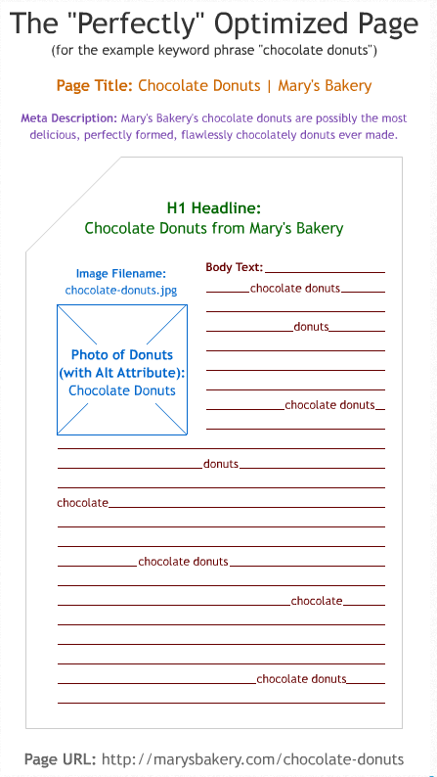
The “Perfect” Page
http://moz.com/learn/seo/on-page-factors
Read and learn this page
The main keyword must be used at least 4 times within the page
Page Title (title tag)
The meta description
Main headline
Within the content

Slide 11
Requirements for an SEO’ed page
750 words for the homepage
500 words for internal pages (including blogs)
Content Audit of the website
Are there pages of content that match the keywords?
Are there city pages?
Is the geographic of the firm or business easily found within the content/website/footer?

Slide 12
Grammatical Concerns
If the keyword is “Washington dc tax attorney,” can you add the periods in between D.C.?
Yes; Google usually ignores punctuation and mathematical symbols from a query because it doesn't index them. They rarely change the meaning of a query.
It is important to the client that their content emphasized all three locations that their firm is in. Are the examples below considered keyword stuffing?
“Our Nashville, Plano and Austin personal injury attorneys are …” (keyword is only appearing once, but this sentence makes it obvious that the law firm has three locations)
“That is what you can expect from the Dallas family law lawyers, Austin family attorneys and Plano divorce lawyers at …”

Slide 13
Grammatical Concerns (cont.)
The keyword phrase is “tax attorney washington dc.” Are these sentences accurate for SEO?
Our tax attorneys are located in Washington DC.
A tax attorney in Washington DC ….
Attorneys vs. attorney and lawyers vs. lawyers. Is the “S” necessary? Is there a difference?

Slide 14
Headlines for SEO & Eyeballs
SEO your Headlines: Keywords should be in the headlines.
Make Headlines Easy to Understand: Short headlines are better than long headlines.
Subheads: If you don’t want your headlines to be SEO’ed, use subheads instead.

Slide 15
Are you an Authority for your Online Content?
Write often
Create in-depth articles that help
Have the most exhaustive resource on your practice area online. Become THE resource.

Slide 16
Duplicate Content
Unique content is key.
Don’t steal and don’t regurgitate.
Previous indexed content takes precedence with Google. Even if its within your own website. Do not copy. Ever.

Slide 17
What NOT to Include in your Content Strategy
Short Pages: 1 paragraph pages. Less than 500 words
Orphan Pages: Pages that don’t link from any other page.
Keyword Stuffing: Forcing keywords into pages.
Duplicate Content – Don’t Copy, even from yourself.

Slide 18
SEO Content Guidelines
By PaperStreet Web Design

